Slide 1
Treatment of Children’s Pain: Analgesics
Pediatric Pain Resource Nurse Curriculum
Notes:
Materials: Participant guide and additional journal articles to be provided to participants at least 1 week in advance.
Flip chart or Whiteboard and Markers
Room Setup: In tables of 4 or 6-8 depending on number of participants
Display slide as participants walk in
This session is 60 minutes
Welcome & Introductions: Introduce facilitator if necessary.
READ: The learning objectives for this content are to:
Explain principles for treating children’s pain with pharmacologic therapies.
Describe how developmental differences influence use of non-opioids, opioids, co-analgesics and adjuvant medications in pediatric pain treatment plans
Develop pediatric multimodal pain treatment plans that demonstrate knowledge of age-related considerations, mechanism of action, indications, route, contraindications, and adverse effects of pharmacological therapies
© 2017 Manworren & Lurie Children’s Hospital
All rights reserved. Version 2019

Slide 2

How are analgesics selected and dosed for children?
Notes:
ASK: How are analgesics selected and dosed for children as compared to adults?
Select participants willing to share their answers to this question.
Write on flipchart or whiteboard
[Limit discussion to 3 minutes]
[5 minutes of 60 minute session is complete]
© 2017 Manworren & Lurie Children’s Hospital
All rights reserved. Version 2019

Slide 3

Key assessments for developing a pain treatment plan
Past/current pain control methods and their effectiveness
Pharmacological
Physical
Psychological
Complementary and alternative medicines
Assess for multiple sites, causes, and types of pain
Obtain a comprehensive medication and pain treatment history
Identify drug-related fears
Notes:
READ these Key points (if not included by participants):
Treat pain based on cause, type, site, and severity
Assess for multiple sites, causes, and types of pain
Assess past and current pain control methods and their effectiveness
Medications and non-drug treatments tried
Their efficacy & adverse effects, including allergies
Concurrent treatments and potential drug-drug interactions
Identify drug-related fears that may lead to inadequate or under-treatment of pain or poor treatment adherence
Give adequate doses
Pediatric patient doses are based on weight , age, and sometimes body surface area
Reassess pain regularly and document assessment
Nurses should administer analgesics at intervals consistent with durations of analgesia. Because of variability of individual drug responses, nurses should determine the duration of analgesics by evaluating patient response and being vigilant for the return of pain.
Evaluate treatment efficacy and document evaluation
© 2017 Manworren & Lurie Children’s Hospital
All rights reserved. Version 2019

Slide 4

Develop a pain treatment plan
Cure sometimes, treat often, comfort always. ~Hippocrates
Treat pain based on cause, type, site, and severity
Develop realistic pain treatment goals
Develop an age and developmentally-appropriate multi-modal pain treatment plan
Notes:
READ:
Develop realistic pain treatment goals. Focus on:
Pain relief or reduction and Functional recovery or restoration
Develop an age and developmentally-appropriate multi-modal pain treatment plan
Both now and in the future, self-report of pain, pain location, quality, and severity will provide additional guidance in developing individualized treatment plans for patients who are able to self-report.
Cause of pain, disease, treatments, and procedures, including surgery, provide guidance for developing pain treatment plans.
This may be the only guidance available to help manage pain in critically ill, pre-verbal, and nonverbal neonates, infants, and children.
In the future, genetics of pain sensitivity and pharmacogenetics may also provide predictive guidance for planning individualized pain treatments.
© 2017 Manworren & Lurie Children’s Hospital
All rights reserved. Version 2019

Slide 5
Pain treatments and interventions
Pharmacokinetics?
Pharmacodynamics?
Pharmacogenetics?
Reprinted from AORN Journal, Vol.101(3), Manworren, RCB, Multimodal Pain Management and the Future of a Personalized Medicine Approach to Pain, pp.307-318 Copyright (2015), with permission from Elsevier.
Notes:
READ: The effect of analgesics and biobehavioral interventions is indicated along the nociceptive pain pathway to illustrate its mechanism of action.
ASK: What are pharmacokinetics, pharmacodynamics, and pharmacogenetics? Do these alter individual treatment plans?
Select participants willing to share their answers to this question. Write on flipchart or whiteboard
[Limit discussion to 3 minutes]
READ these Key points (if not included by participants):
Pharmacokinetics is what the body does to the drug.
Pharmacodynamics is what the drug does to the body, and
Pharmacogenetics is the influence of individual allelic differences and associated variability in medication responses.
READ: Thus, one size does not fit all, and the treatment plan may need to be adjusted to address individual variability in pain experience and analgesic efficacy.
[10 minutes of 60 minute session is complete]
© 2017 Manworren & Lurie Children’s Hospital
All rights reserved. Version 2019

Slide 6
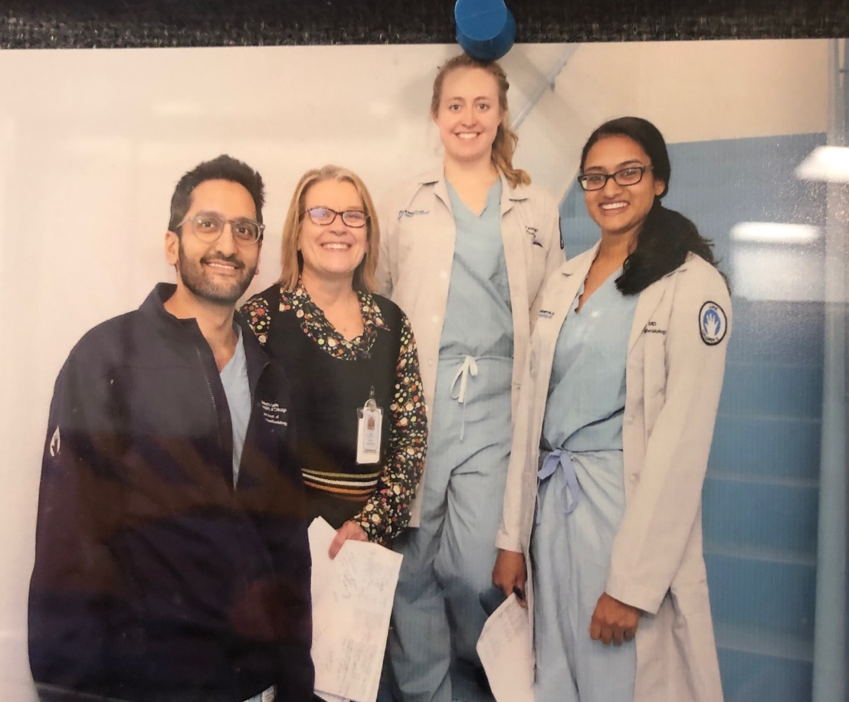
Implement pain treatment plan
Other pediatric considerations
Dosage forms available
Dosing schedule
Availability & Affordability
Notes:
ASK: What do you do when a child refuses to take a liquid analgesic?
Select participants willing to share their answers to this question.
Write on flipchart or whiteboard
[Limit discussion to 3 minutes]
READ these Key points (if not included by participants):
Since medications are dosed based on weight, a tablet or capsule is may be “one size fits all”.
Consider the dose being prescribed as well as whether the patient will take the liquid form of the medication.
Bitter medications can often be masked by citrus, so mixing in orange juice can help. Chocolate syrup is another agent that can be helpful for some children. Consider whether there are other forms of the drug the child will tolerate.
Consider frequency and challenges to schedule adherence like school, sleep, and timing around meals.
Some prescription medications and most over-the counter medications are not covered by insurance, so they may be cost-prohibitive
Many oral suspensions are not readily available and may need to be extemporaneously compounded
© 2017 Manworren & Lurie Children’s Hospital
All rights reserved. Version 2019

Slide 7
Patty
Patty is a non-verbal, 3 year old female (14kg) with cerebral palsy, g-tube, and recent diagnosis of non-hemorrhagic pancreatitis. She is NPO and has the following orders:
Morphine IV every 4 hrs PRN,
Acetaminophen IV every 6 hrs PRN, and,
IV ketorolac every 6 hrs.
She is on her last dose of a total of 48 hrs of ketorolac. Her parents report that Patty is in constant abdominal pain
What is your multimodal pain management plan?
Consider both analgesics and biobehavioral interventions.
Notes:
READ: Patty is on her last dose of a total of 8 of ketorolac. Her parents report Patty is in constant abdominal pain, not sleeping at night, and gagging. Patty is comfortable only in the fetal position or when being held. Her rFLACC scores range from 4-8/10
This is a 10 minute case, with your table discuss your answers to the questions on the slide. You will have 5 minutes to discuss the case and prepare to share your plan with the group
[Give groups 5 minutes to discuss case. During their discussion:
Write age, weight, and medication orders on flipchart or whiteboard] Select participants willing to share their group’s answers.
[LIMIT discussion to 1-2 mins/group, max of 5]
Write changes to the plan on flipchart or whiteboard
READ these Key points (if not included by participants):
Consider changing the morphine to as often as every 1-2 hours and giving the morphine and acetaminophen around the clock.
To ascertain if continuing the IV ketorolac is contraindicated, obtain a BUN and creatinine. If these labs are in acceptable ranges, continue the IV ketorolac for a maximum of 20 doses.
Nonpharmacological interventions include positions of comfort, but continue to change positions, adapt environment as guided by family’s past experiences with Patty’s pain.
Provide distraction type activities, music, and if possible, consult a child life specialist
[25 minutes of 60 minute session is complete]
PRN Program: Analgesics
© 2017 Manworren & Lurie Children’s Hospital
All rights reserved. Version 2019

Slide 8
Implement pain treatment plan
Non-opioids | Opioids | Co-analgesics or Adjuvant Analgesics | Other Adjuvants
Ceiling of analgesia | Historically considered not to have a ceiling of analgesia | Analgesia may or may not be the primary indication for these drugs Ceiling of analgesic effect or adjuvant effect | Used to treat related problems, such as insomnia, depression, and anxiety Used to treat analgesic adverse effects, like opioid- induced constipation
Notes:
READ:
The mainstays of analgesia are non-opioids and opioids. However, there are many other medications commonly included in patient treatment plans to treat pain, associated symptoms and conditions, and analgesic adverse effects. These medications may or may not have analgesia as a primary treatment indication.
You will now have 1 minute to write down every medication you can think of that may be appropriate for a pediatric pain treatment plan.
Ready, set, go!
ASK: Who has over 10 medications written down? 15?
[Identify participants with the most and have them read their lists and then compare them with the list shown on the next slide]
[Limit discussion to 2 minutes]
© 2017 Manworren & Lurie Children’s Hospital
All rights reserved. Version 2019

Slide 9
Medications
Non-opioids | Opioids
Acetaminophen NSAIDs Aspirin Choline magnesium trisalicylate Ibuprofen Naproxen Ketoprofen Indomethacin Meloxicam Ketorolac Diclofenac Celecoxib | Full Agonist Codeine Fentanyl Hydromorphone Hydrocodone Levorphanol Morphine Meperidine Methadone Oxycodone Oxymorphone Partial Agonist Buprenorphine Mixed Nalbuphine Antagonist Naloxone Naltrexone Dual Action Tramadol Tapentadol
+
Notes:
READ: How do you manage dosing of pediatric patients?
Based on the type of medication, you might use weight, age, or body surface area.
Many medications have not been studied in pediatric patients and dosing may be empirical or extrapolated from recommendations for adults
Medications may need to be adjusted based on individual patient response and adverse effects
In general, drug dosing assumes patients are extensive metabolizers (EM), since this is the largest proportion of the population.
[30 minutes of 60 minute session is complete]
© 2017 Manworren & Lurie Children’s Hospital
All rights reserved. Version 2019

Slide 10
+
Patty, continued
What are the advantages and disadvantages of these treatment plans?
Oral/G-tube hydromorphone
Oral/G-tube oxycodone
Oral/G-tube methadone
Notes:
READ: Patty has been receiving IV hydromorphone for 3-4 weeks. Dosing has increased to a total daily dosage of 3mg or 3000mCg/day. She is tolerating G-tube feedings and is not sedated.
ASK: What are some advantages or disadvantages to the suggested oral/g-tube opioid(s) for her discharge home?
Select participants willing to share their answers to this question.
[Limit discussion to 3 minutes]
READ these Key points (if not included by participants):
1. Liquid hydromorphone:
Is it available from family’s home pharmacy?
How much needs to be given and since it needs to be given every 3-4 hours, will the schedule be convenient for the family
Educate family about: Weaning schedule, withdrawal assessment, storage of medication, and disposal of any remaining medication.
2. Liquid oxycodone: same as above.
3. Liquid Methadone: same as above and
May take several days to find the best dose. Monitor for both sedation and withdrawal.
Obtain ECG prior to start due to potential for prolongation of QTc (cardiac).
Adherence with methadone every 12 hours may be easier for the family than every 4 hours for short-acting opioids
PRN Program: Analgesics
© 2017 Manworren & Lurie Children’s Hospital
All rights reserved. Version 2019

Slide 11
Opioid dosing: ROSTERS
Risk assessment
Optimize multimodal for opioid-sparing effect
Start low, go slow
Titrate to effect
Evaluate efficacy
Reevaluate continued need for opioids
Secure, monitor, and dispose
R
O
S
T
E
R
S
Notes:
READ:
ROSTERS is an acronym of steps for opioid prescribing and monitoring your “rosters” of patients prescribed opioids for use at home
READ: slide
[35 minutes of 60 minute session is complete]
© 2017 Manworren & Lurie Children’s Hospital
All rights reserved. Version 2019

Slide 12
Opioid-related adverse effects
Adverse effects
Constipation
Nausea/ Vomiting
Sedation
Respiratory Depression
Pruritis, hypnogotic myoclonus
Euphoria, dysphoria, hallucinations
Urinary retention
To treat common adverse opioid effects, use other multimodal (opioid-sparing) therapies
Food does NOT decrease opioid-related nausea & vomiting
Sedation ALWAYS precedes respiratory depression
Respiratory depression is rare in patients on stable opioid doses
Patients develop tolerance to all opioid-related adverse effects except constipation
Notes:
READ: To treat common adverse opioid effects use other multimodal (opioid-sparing) therapies. Remember:
Taking opioids with food does NOT decrease nausea/vomiting
Sedation always precedes respiratory depression
Respiratory depression is rare in patients who have been on stable opioid doses
Patients develop a tolerance to opioid-related side effects with continued use, except constipation.
© 2017 Manworren & Lurie Children’s Hospital
All rights reserved. Version 2019

Slide 13

Sangeeta
Sangeeta is a 9 year old female who presents in a walking boot on LLE and ambulating with crutches.
She was stepped on during a soccer game 6 weeks ago and has had ongoing burning pain since that time.
X-rays and MRI are negative.
Orthopedics recommended physical therapy and gradual return to activity.
She has been unable to participate in physical therapy secondary to pain
What kind of pain does this child have?
What pharmacologic and biobehavioral interventions would you consider for this patient?
Notes:
READ: Sangeeta has been unable to participate in physical therapy secondary to pain. She is unable to walk without boot or crutches.
Sleep and school attendance have been poor. Physical exam reveals trophic changes, swelling, muscle atrophy, weakness, and allodynia. She expresses extreme anticipatory fear and pain with physical exam. Based on Budapest Criteria, she was diagnosed with CRPS.
This is a 10 minute case, with your table discuss your answers to the questions on the slide. You will have 5 minutes to discuss the case and prepare to share your plan with the group
[Give groups 5 minutes to discuss case]
Select participants willing to share their group’s answers.
[LIMIT discussion to 1-2 mins/group, max of 5]
Write changes to the plan on flipchart or whiteboard
READ these Key points (if not included by participants): Pain education is the essential first step of treatment. Her treatment goal is full functional restoration. Her treatment plan should be interdisciplinary, with the gold standard combination of
physical therapy (to progress through graded motor imagery and address physical impairments),
pain psychology (to address pain, fear, and other psychosocial and family factors using cognitive behavioral interventions, mindfulness, skills training), and
Pharmacologic. Possible considerations for her neuropathic pain are:
Gabapentin 3 times/day @ 8-35mg/kg/day – start low & taper up or pregabalin twice/day @ 75mg BID up to max of 300mg BID.
Lamotrigine or duloxetine (Cymbalta®) if she has a mood disorder.
Muscle relaxant, like baclofen 30-60 mg/day. Benzodiazepines are not the 1st choice for chronic pain.
Alendronate to address or prevent bone loss.
Compounded ketamine creams
Vitamin C&D supplementation
NSAIDS or corticosteroids for inflammation
PRN Program: Analgesics
© 2017 Manworren & Lurie Children’s Hospital
All rights reserved. Version 2019

Slide 14
Medications
Co-analgesics and Adjuvants
Antidepressants Anticonvulsants Steroids NMDA receptor antagonists Alpha2-Adrenergic agonists Local anesthetics Muscle relaxants and anxiolytics Antispasmotics Capsaicin Cannabis
+
Notes:
READ: Review your 1 minute list.
ASK: Which of these was not on your list and not mentioned, but may be appropriate to treat Sangeeta’s pain?
[Select participants willing to share their answers].
[Limit discussion to 2 minutes]
[50 minutes of 60 minute session is complete]
© 2017 Manworren & Lurie Children’s Hospital
All rights reserved. Version 2019

Slide 15

https://creativecommons.org/licenses/by-sa/4.0/deed.de#
Let’s evaluate the literature . . .
Which topical anesthetic is best?
What are the risks of using ketorolac after surgery?
PCA with or without continuous infusion?
Why were codeine and tramadol taken off the formulary?
Notes:
READ: You were provided with published studies about these topics.
ASK: Based on these published studies, what are your conclusions?
[Select participants willing to share their answers to these questions].
[Limit discussion to 8 minutes]
[58 minutes of 60 minute session is complete]
PRN Program: Analgesics
© 2017 Manworren & Lurie Children’s Hospital
All rights reserved. Version 2019

Slide 16


Please refer to the online assessment tool.
How would you rate your ability to determine risks and benefits of different analgesic pain treatments for children of all ages?
What resources do you need to review with your team?
What is your next step for advancing pharmacologic treatments for children?
Notes:
ASK: Are there any questions?
[60 minute SESSION COMPLETE]
© 2017 Manworren & Lurie Children’s Hospital
All rights reserved. Version 2019

